Slide 1
Going Hybrid with Exchange
Alberto Pascual | Nacho Sánchez-Beato
Notes:
This slide is mandatory. Please do not remove.

Slide 2
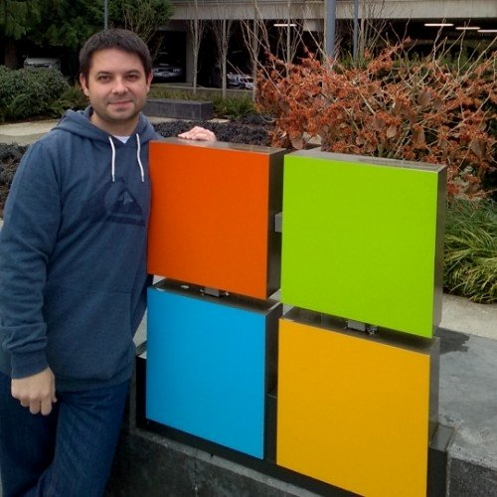

Alberto Pascual
Nacho Sánchez-Beato
Exchange Online Support Engineer
Exchange Support Escalation Engineer
Microsoft
Microsoft
http://aka.ms/spainexchangeblog
@msftcommspain

Slide 3
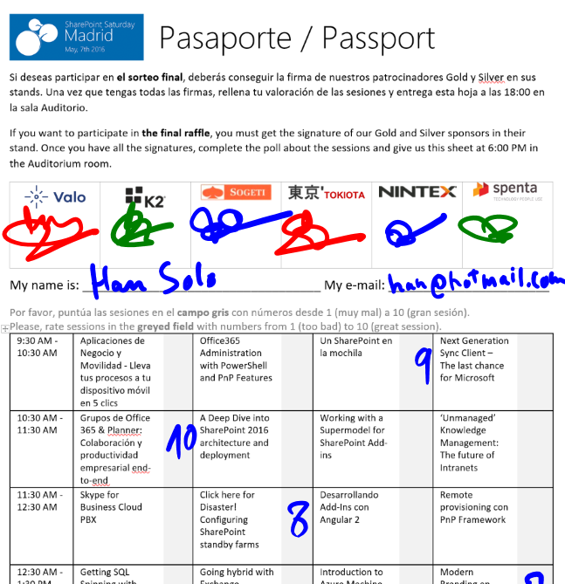
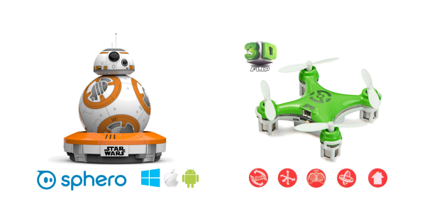
Raffle
Please, fill your SPS Madrid passport if you want to participate.
You must get signature from sponsors and complete the poll.
Give us the passport at 6:00 PM in the Auditorium room.
You can win one Sphero BB-8 or a mini drone:

Slide 4
Agenda
Migration Types
Why hybrid?
HCW timeline
How Exchange 2010 is different than Exchange 2013/2016 on this.
DEMO HCW
DEMO mailbox moves
TS Assistant
Q & A

Slide 5
Ways to migrate
Deployment Complexity
EASY
Really?
Hybrid
Cutover
Staged
DirSync/Identity Management
Hybrid Configuration Wizard, oAuth,MRS, ….
Same Outlook profile
Batch Approach (up to 100 concurrent moves)
Offboarding
Rich Coexistence
No Additional Servers
Cloud ID’s Only
New Outlook profile
All at Once…
DirSync needed
No 2010/2013/2016
New Outlook profile
Batch Approach
Really?
End User Complexity
EASY

Slide 6
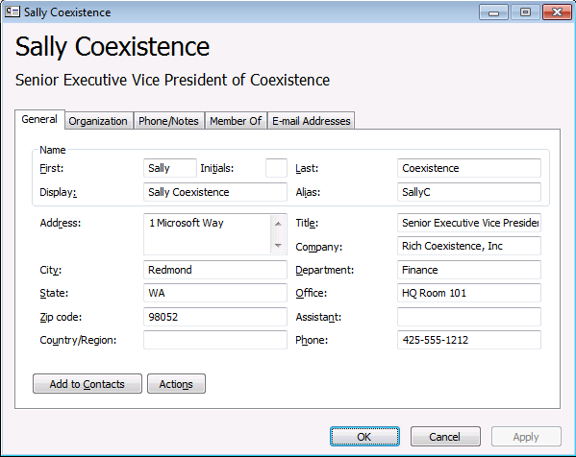
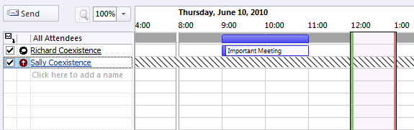
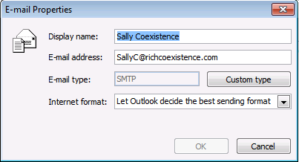
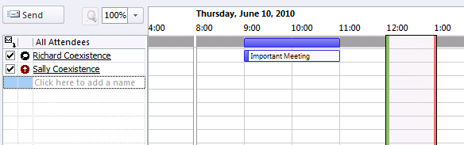
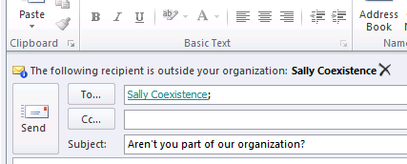
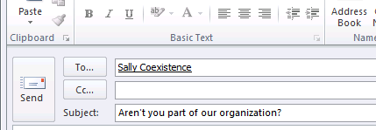


Why Exchange Hybrid?
Address Book
User Experiences
Calendaring & Free/Busy
Messaging
Mail
Migrations
Exchange on-premises
MRS
Mailbox data
Office 365

Slide 7
Exchange Hybrid Wizard History
1
2
3
4
5
6
7
Exchange 2010 SP1
72 pages of documentation
Exchange 2010 SP2
HCW introduced
Exchange 2013
HCW with web-based UI
Exchange 2013
SP1
Exchange 2013
CU5
Exchange 2013
CU10 and 2016
Exchange 2010
Extremely complex and low adoption
Removed confusing requirements for additional domains: exchangedelegation and service.contoso.com
Greatly simplified transport configuration
Multiple exchange organizations now supported
Supports Exchange
2013 Edge
Native OAUTH
Office 365 HCW
Office 365 HCW

Slide 8
Performance tunning for migrations
Unified management
Support for cross-premises permissions
Message Rights Management (MRM)
Exchange In-place eDiscovery
Exchange In-place Archiving
Session affinity vs stateless
Exchange 2010
vs Exchange 2013/2016
Notes:
Cross-Premises permissions: We don’t, however, support the use of the Send-As, Receive-As, or Send on behalf of mailbox permissions in hybrid deployments between on-premises Exchange and Office 365 organizations. These permissions are only available when both the mailbox granting the permissions, and the mailbox receiving the permissions, are in the same organization. Any mailboxes that receive these permissions from another mailbox need to be moved at the same time as that mailbox. If a mailbox receives permissions from multiple mailboxes, that mailbox, and all of the mailboxes granting permissions to it, need to be moved at the same time. In addition to these permissions, the Auto Mapping feature is also unsupported when used between mailboxes in the on-premises Exchange and Office 365 organizations.
MRM, In-place archive and in-place eDiscovery is possible through OAUTH

Slide 9
Moving mailboxes How Exchange 2010 is different than Exchange 2013/2016
<MRS>
/ews/mrsproxy.svc

Slide 10
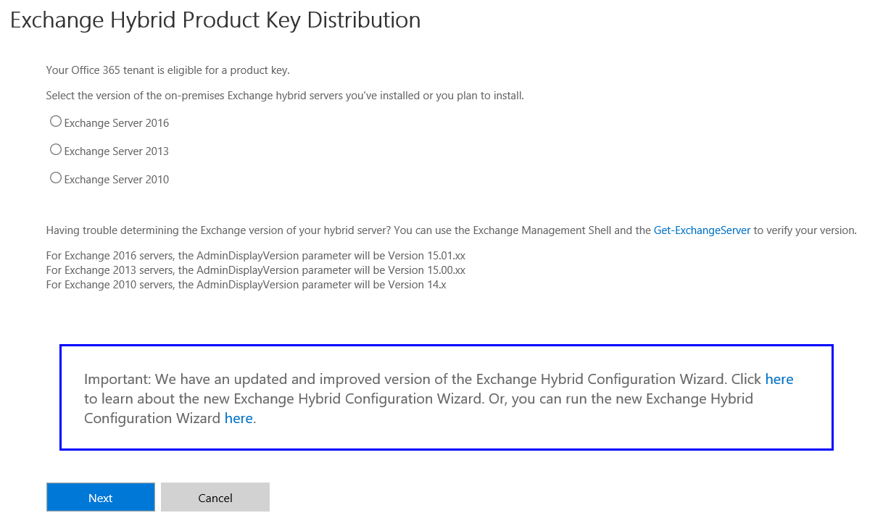
Hybrid Product Key
You get a free Hybrid Edition key if…
You have an existing, non-trial, Office 365 Enterprise subscription
You currently do not have a licensed Exchange 2013 or Exchange 2010 SP3 server in your on-premises organization.
You will not host any on-premises mailboxes on the Exchange 2013 or Exchange 2010 SP3 server on which you apply the Hybrid Edition product key.
Short Link: http://aka.ms/hybridkey
KB Link: http://support.microsoft.com/kb/2939261

Slide 11
DEMO
HCW and moves
Notes:
Demo HCW
Demo Mailbox Moves (2013 and 2010)
Show report of result

Slide 12
Troubleshooting mailbox moves
The hard way:
Check move request statistics generated log
Get-MoveRequestStatistics user@contoso.com -IncludeReport | fl
The easy way:
Use the Hybrid Troubleshooting Assistant
https://aka.ms/tomm
Tips:
Beware that number of domains are not greater than 238
SSL Offloading is not supported on MRS
If Exchange 2010, check session affinity

Slide 13
DEMO
Meet TOMM

Slide 14
Notes:
This slide is mandatory. Please do not remove and try to use it during Q&A at the end of your session. Thank you!

Slide 15
Questions?
(if any…)

Slide 16
2013 Walkthrough

Slide 17
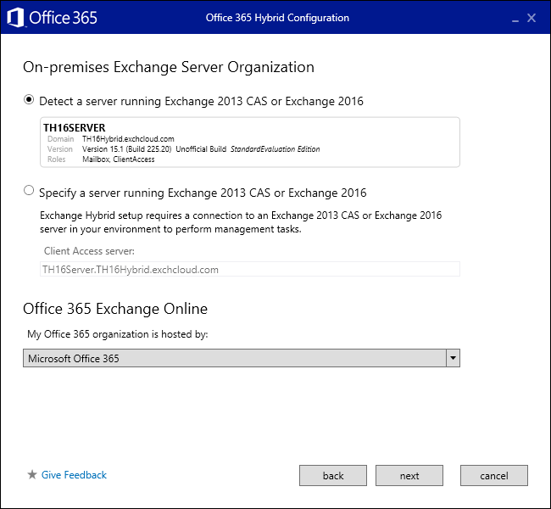
Server detection page
The configuration will be done from this server
We check local AD for a list of all Exchange servers and version (this is not a remote call)
1st see if the server we are on is running the latest version
2nd we look to see if a server in site is running the latest version
3rd we cross sight to connect to a random server running the latest version
You can manually override this logic
You can also specify 21v from this page

Slide 18
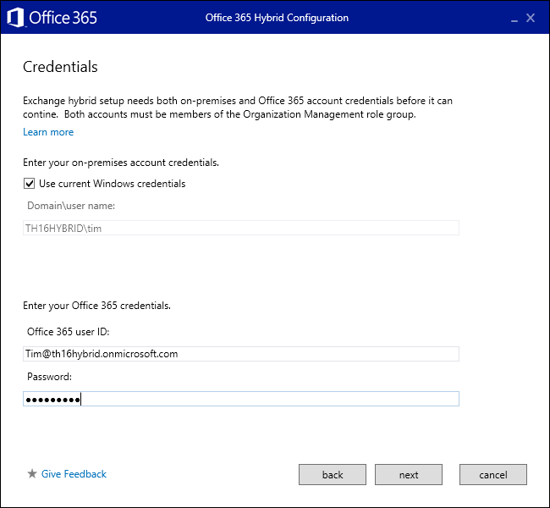
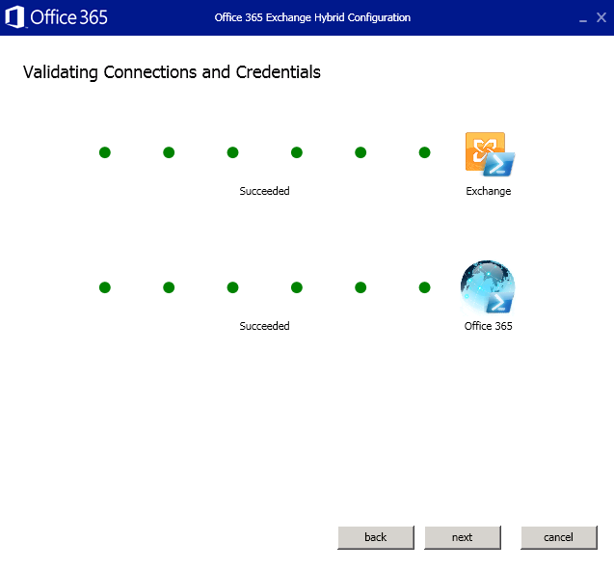
Credential page
We do not force you to enter your on-premises credentials
You then just provide the cloud creds and we connect

Slide 19
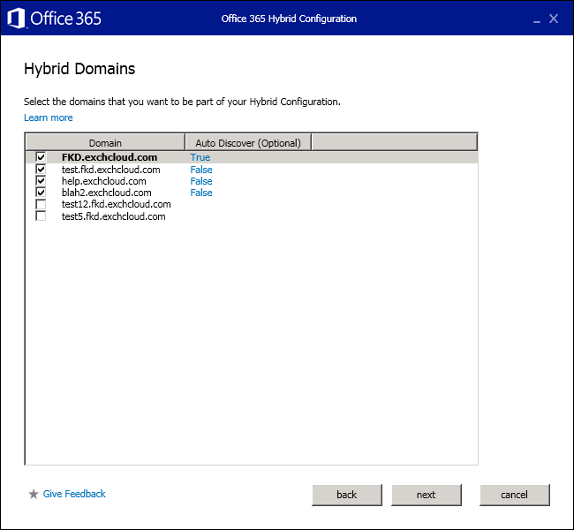
Shared namespace page
We then show you a list of domains that are accepted in both on-premises and EXO
This is were you choose your shared domain

Slide 20
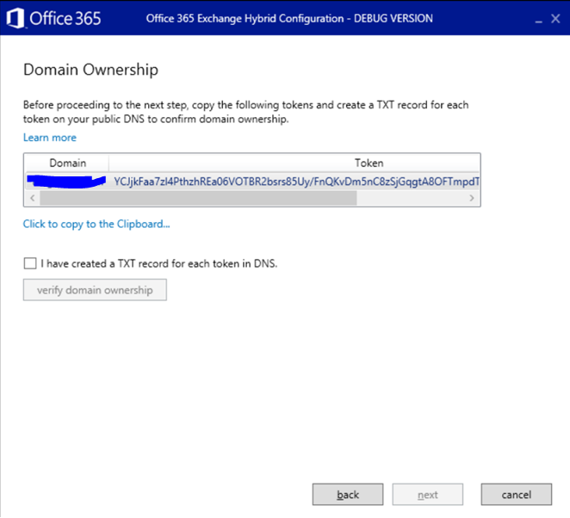
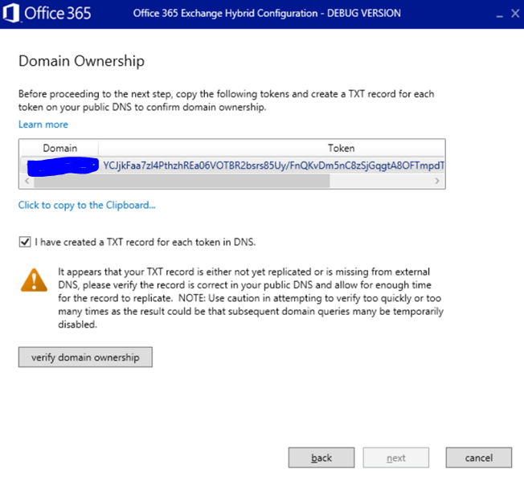
Domain Proof
We now copy just the string needed, no extra garbage

Slide 21
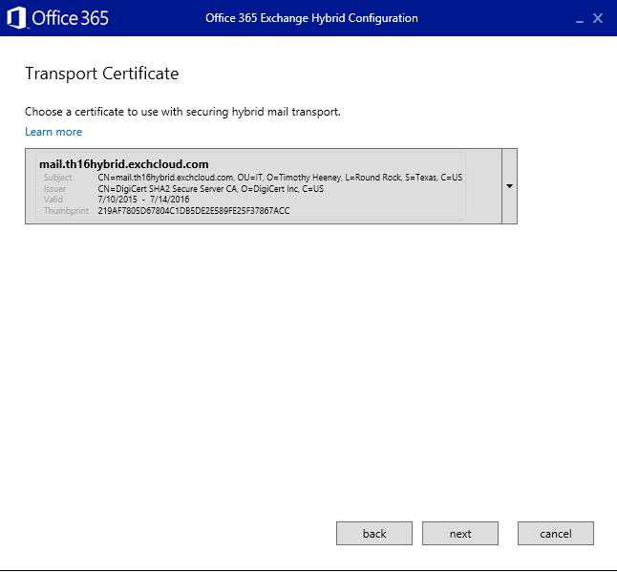
Transport Certificate
We then show a list of valid certs..
Third Party Cert
SMTP Service Assigned
Installed properly on Exchange
Not Self Signed

Slide 22
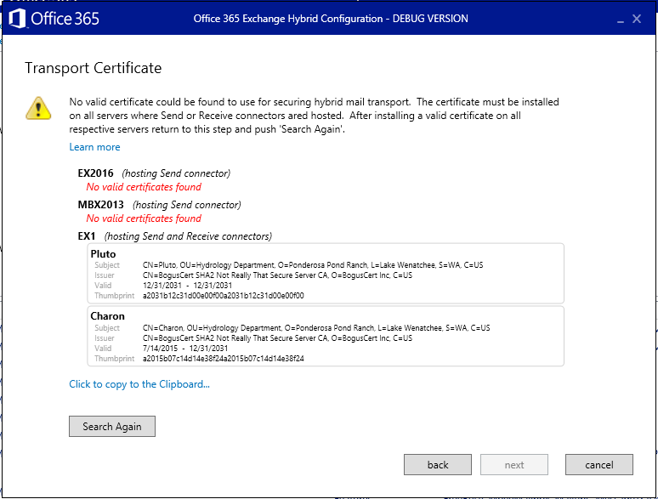
Certificate field is empty
Certificate field is empty when running the HCW
Certificate not correctly installed
Certificate requirements not met
Third Party
Proper SAN
Assigned to SMTP Service
Private Key
Required on selected CAS & MBX
CAS are used for Receive Connectors
MBX are used for send Connectors
Both need same cert installed, else HCW won’t show.
CRL Blocked
Need access to CRL url over 80 from all servers

Slide 23
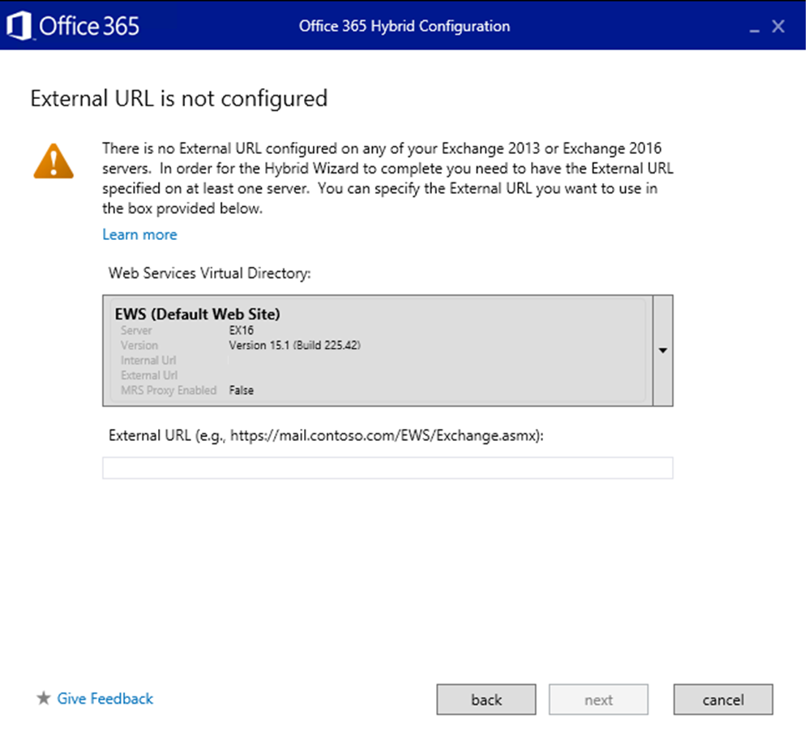
Missing External URL?

Slide 24
DAuth vs OAuth
DAuth
Uses Microsoft Federation Gateway for Token generation
Organization Relationships
Controls what companies you share information with
Allows for granular control of what features are available (free busy, mailtips)
OAuth
Uses Auth Server in Azure AD (better resiliency and faster in forest communications)
IntraOrgConnectors /Configuration
Controls what companies you can share information with
No granular control of feature-set (all or nothing)
Microsoft Federation Gateway
Organization
Relationships
AuthServer
Intraorg
Connectors

Slide 25
Troubleshooting mailbox moves
Checking the important stuff on the moverequeststatistics log:
Identity
MailboxIdentity
ExchangeGuid
ArchiveGuid
Status*
Sync*
Flags
Direction
Priority
WorkloadType
Suspend*
RecipientTypeDetails
Source*
Target*
RemotehostName
BatchName
Remote*
BadItem*
*LargeItems*
*TimeStamp*
*Duration
TotalMailbox*
PercentComplete
Failure*
Report

